Slide 1
Remedial Waterproofing BART Powell Street Station Using Injection Grout
Tom Butt, FAIA, LEED AP BD+C
Interactive Resources

Slide 2
Disclaimer
Identity of proprietary products is provided for information only and does not constitute an endorsement by ICRI or by Interactive Resources.

Slide 3
Project Scope
23,600 SF (approximately) Injection grout waterproofing south side of Mezzanine
Asbestos abatement (existing original fireproofing) and new fireproofing
Traffic coating at vent structure
Added some injection grouting on north side of Mezzanine and Crystalline waterproofing at emergency vent structure

Slide 4
Powell Street Station - History
Designed 1970
Opened 1973
Busiest station on BART system
“Cut and cover” construction
Original waterproofing – Bentonite
Years of BART unsuccessful attempts to stop leaks using epoxy injection of cracks

Slide 5
Leak Map - 2012
STEAM LINE

Slide 6
Leak Map 2012 Enlarged

Slide 7
Steam Pipe
Steam at 350º F
3-4 inch calcium silicate insulation
3-4 inch concrete cover
Temperature under steam pipe at top of 8-inch ceiling slab = 142º F
Temperature under steam pipe at bottom of 8-inch ceiling slab = 115º F
Temperature 3 ft. away from centerline of steam pipe at top of 8-inch ceiling slab = 120º F

Slide 8
Sections – Injection Grouting

Slide 9
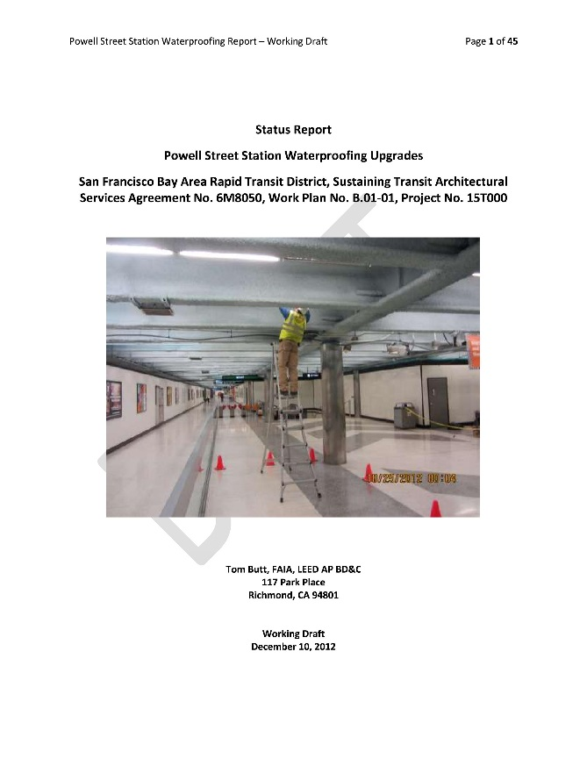
History
2007-2009: Jacobs study and Pilot Projects A-D
2011-2015: Kwan Henmi/Interactive Resources studies, Pilot Project E and current Project 15IF-120

Slide 10
Jacobs Pilot Project A
Contractor: Rainbow Waterproofing
Injection Grout: Prime-Flex 920, hydrophobic polyurethane used to form a “cutoff”
Prime-Flex 900 XLV hydrophilic polyurethane for grout “curtain”
“Immediate cessation” of leaks reported but new active leaks appeared in 2012

Slide 11
Jacobs Pilot Project B and D
Contractor” Blues Roofing
Hydro Cut Active, hydrophobic polyurethane used for grout curtain
Some leakage continued

Slide 12
Jacobs Pilot Project C
Contractor: Re-Systems
TurboSeal used for grout curtain
Waterproofing appeared effective but TurboSeal has continued to drip from the ceiling causing serious stains.
Routing and sealing of cracks with epoxy grout ineffective in stopping TurboSeal drips

Slide 13
TurboSeal Stains

Slide 14
Failed TurboSeal Patches

Slide 15
Jacobs Final Recommendations
Recommended hydrophilic polyurethane grout
Prepared draft waterproofing remediation drawings and specifications in 2011
Specified contractor’s choice of hydrophilic or hydrophobic polyurethane grouts as well as “elastomeric polymer rubber grout” (TurboSeal), Bentonite and acrylic grouts
Project never implemented

Slide 16
Interactive Resources
Kwan Henmi Architecture/Planning awarded consulting contract in 2011
Interactive Resources sub-consultant to Kwan Hemni
Initial scope:
Review of prior tests, reports, drawings and specifications
Validation of the chosen approach
Review and recommendations of selected materials
Provide specifications for inclusion in contract documents per recommendations
Recommendations for optimizing performance in a competitive bid delivery method

Slide 17
Interactive Resources/Kwan Henmi Investigation
Mapped leak locations – clustered in vicinity of steam pipe
Contacted vendors and manufacturers of grout products
Additional borings confirmed existing Bentonite waterproofing and wet sand fill
Eliminated all products except polyurethanes based on results of pilot projects, new information from exploratory cores and extensive review with vendors and manufacturers
Hydrophobic polyurethane was consensus choice

Slide 18
Additional Exploratory Coring

Slide 19
Additional Exploratory Coring

Slide 20
Pilot Project E – Completed April 3, 2013
Approximately 3,000 SF of ceiling area
Informally bid by Interactive Resources as part of consulting contract and services
Rainbow Waterproofing low bidder at $157,350 approximately $52.45/SF
DeNeef Cut PURe hydrophobic urethane
5-year manufacturer warranty
Final cost $208,161 ($69,397/SF) based on additional grout required

Slide 21
Pilot Project E - Payment for Anomalies
Computed based on net additional grout required for square foot of surface area compared to average required for all areas

Slide 22
Pre-Bid Grout Product Prequalification Contract 15IF-120
Avanti 248 LV or HV 275 hydrophobic
DeNeef CUT PURe hydrophobic
Sika SikaFix HH+ and SikaFix HH LV hydrophobic
Prime Resins Prime-Fex900 XLV Hydrophilic and Prime-Flex 920 hydrophobic
SealBoss 1500 Series
Five successful projects
References must be owners or owners’ representatives, not general contractors.
Mountain Grout had too few references from owners

Slide 23
Estimate Versus Bid – February 2014
Item | Description | Estimate | Shared Systems Technology
1 | Mobilization | $25,000 | $25,000
2 | Injection Grout Waterproofing | $2,390,000 | $1,286,672
3 | Traffic Coatings | $58,000 | $55,000
4 | Asbestos Abatement | $721,000 | $423,558
5 | Differing Site Conditions | $200,000 | $200,000
 | Total Base Bid | $3,394,000 | $1,990,230

Slide 24
Project 15IF-120 Initial Mockup – September 22, 2014

Slide 25
Traffic Coating Vent Structure – Sikalastic 720

Slide 26
Waterproofing Train Control Room Ceiling (Emergency Vent Shaft)
Inside of Emergency Ventilation Shaft
Other side of wall in Train Control Room

Slide 27
Emergency Vent Shaft Waterproofing
Originally specified urethane traffic coating
Emergency ventilation must operate in an ambient atmosphere of 250 degrees C or 482 degrees F for a minimum of 1 hour
Changed to crystalline waterproofing (Xypex)

Slide 28
Spalls
Several spalls encountered in concrete ceiling
All proximate to steam pipe
Heat probably played a role in concrete failure
Repair is challenging primarily because of high temperature conditions

Slide 29
Spall Repair Mockup #1 – Hand Packed Repair Mortar

Slide 30
Spall Repair Mockup #1
Sika top 111 Plus
Polymer modified cementitious
Hand applied
Workability issues at high temperatures

Slide 31
Spall Repair Mockup #2 – Hand Packed Magnesium Phosphate Mortar

Slide 32
Spall Repair Mockup #2
Loctite Fixmaster MagnaCrete/MagnaGrout
Magnesium phosphate-based
Hand applied
Workability issue at high temperature

Slide 33
Spall Repair Mockup #3 – Formed and Pumped Grout

Slide 34
Spall Repair Mockup #3
5-Star Fluid Grout 100
Cementitious
Pumped and formed
Adhesion issues
Significant labor costs

Slide 35
TurboSeal Repair
Original Mockup
Latest Mockup
Rout and seal with polymer modified grout
Epoxy Coating
Backer rod in all routed and cleaned cracks.
Sikaflex 2cNS
V-Wrap 700 Epoxy adhesive and Carbon Fiber Reinforced Polymers (CRFP) V-Wrap C200 strips 12” wide at 24” O.C. to the underside of the ceiling slab
one coat of V-Wrap 700 Epoxy adhesive over the entire area
BASF Master Product HB 400 acrylic coating (Flame Spread 1)

Slide 36
Turbo Seal Mockup #1 Failure
Sikagard 62 Epoxy Coating

Slide 37
Spall Repair Mockup #4 – Epoxy Grout
Structural Technologies V-Wrap 700 extended with sand

Slide 38
Final Cost
Contract Award Amount | $1,990,230
Change Orders | $853,461
TOTAL FINAL |  | $2,843,691

Slide 39
Conclusions
What appeared to be a waterproofing problem turned out to be exacerbated by a heat problem
The injection grouting using hydrophobic polyurethane was effective in mitigating the water leakage
Spall repair is challenging, and mockups to test products and techniques are critical
We are increasingly dependent on technical support by manufacturers and vendors of proprietary products who must be honest and ethical in providing product information and recommendations

